Slide 1

Spreetail + Senior Design
Release One
Notes:
Introductions

Slide 2
Agenda
Problem & Solution
Vision Statement
Scope
Justification
Assumptions, Constraints, & Dependencies
Execution Plan
Demo
Next steps
Notes:
Ant

Slide 3
Problem
Spreetail wants 360° photography of items
Manual photography = long process
Spreetail increasing number of items in warehouses
Need fast/automated way to take high quality photography
Notes:
Ant

Slide 4
Solution
Develop hardware and software solutions for taking photos
Hardware
Two cameras on a tripod
Camera controller
Turntable ~1-2 rpm ~75-100 lbs
Software
Camera control
Web Server
Serve HTTP requests
Send signals to controller to begin photo process
Front end GUI
Send requests to web server
Display/Save/Discard images on demand
Notes:
Jared

Slide 5
Vision Statement
“Produce a solution to invoke and control camera hardware to quickly and efficiently take high quality 360° photography of products.”
Notes:
Jared

Slide 6
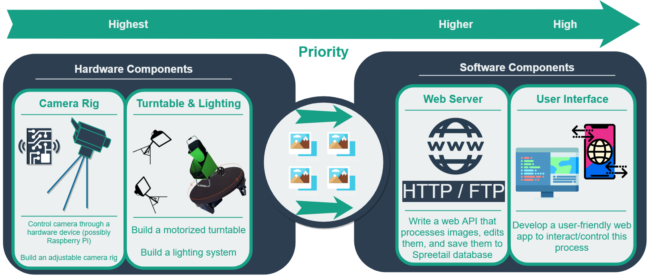
Scope
Extended
Display for 360° images
3D Models
Icons made by Freepik from www.flaticon.com
Notes:
Taher

Slide 7
Justification
Good photography
Customers more likely to buy
Increase sales/revenue
Efficiency
Many different products in warehouses
Need to snap photos quickly & easily
Competition
Sets Spreetail apart with photography
Notes:
Taher

Slide 8
Assumptions
Viable Solution
Controlling Camera with Hardware
Constantly Spinning Turntable
No data loss
Portable Rig
Tripod
Support Two Cameras
Notes:
Brett

Slide 9
Constraints
Budget
Efficient solution with low cost
Time
Each iteration should be completed on time
Milestones completed and ready for each release
Final project should be completed and presented at the end of Senior Design
Turntable
Type – Must be electric, plugged into standard 110V outlet
Weight – Turn at a constant speed up to 75 to 100 lbs.
Speed – Rotate at a speed around 2 rpm, adjustable speed preferred.
Cost – Must be affordable and efficient.
Notes:
Brett

Slide 10
Constraints
Camera
Quality - Decent quality
Speed - One photo per second
Control - Controllable by external hardware
Focus - Quick autofocus
Hardware
Within budget constraint
Quick & efficient data transfer
Software
Third party libraries to control cameras
Notes:
HaoZhou

Slide 11
Dependencies
Camera
Speed of turntable
Third party library
Camera Control Software
Supports selected camera
Notes:
HaoZhou

Slide 12
Execution Plan
Title | Description | Date
Release 1 | Project research and planning initial prototyping. | Friday October 5th
Release 2 | Completed and built hardware rig | Friday November 2nd
Release 3 | Software to control cameras and take photos of rotating item. | Friday December 7th
Release 4 | Web server to handle HTTP requests. | TBD
Release 5 | Front End GUI | TBD
Release 6 | Front End GUI (continued), 3D models, project conclusion. | TBD
Notes:
Yang

Slide 13
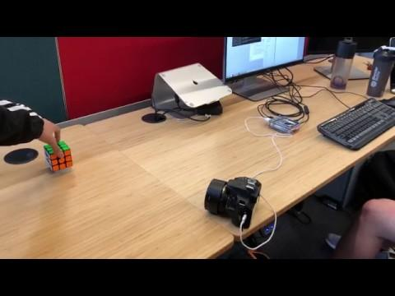
Demo
Notes:
Jared

Slide 14
Demo
Notes:
Jared

Slide 15
Next Steps
Begin further research for hardware rig
Make decisions/purchases
Progress through building/prototyping hardware rig
Notes:
Yang

